Slide 1


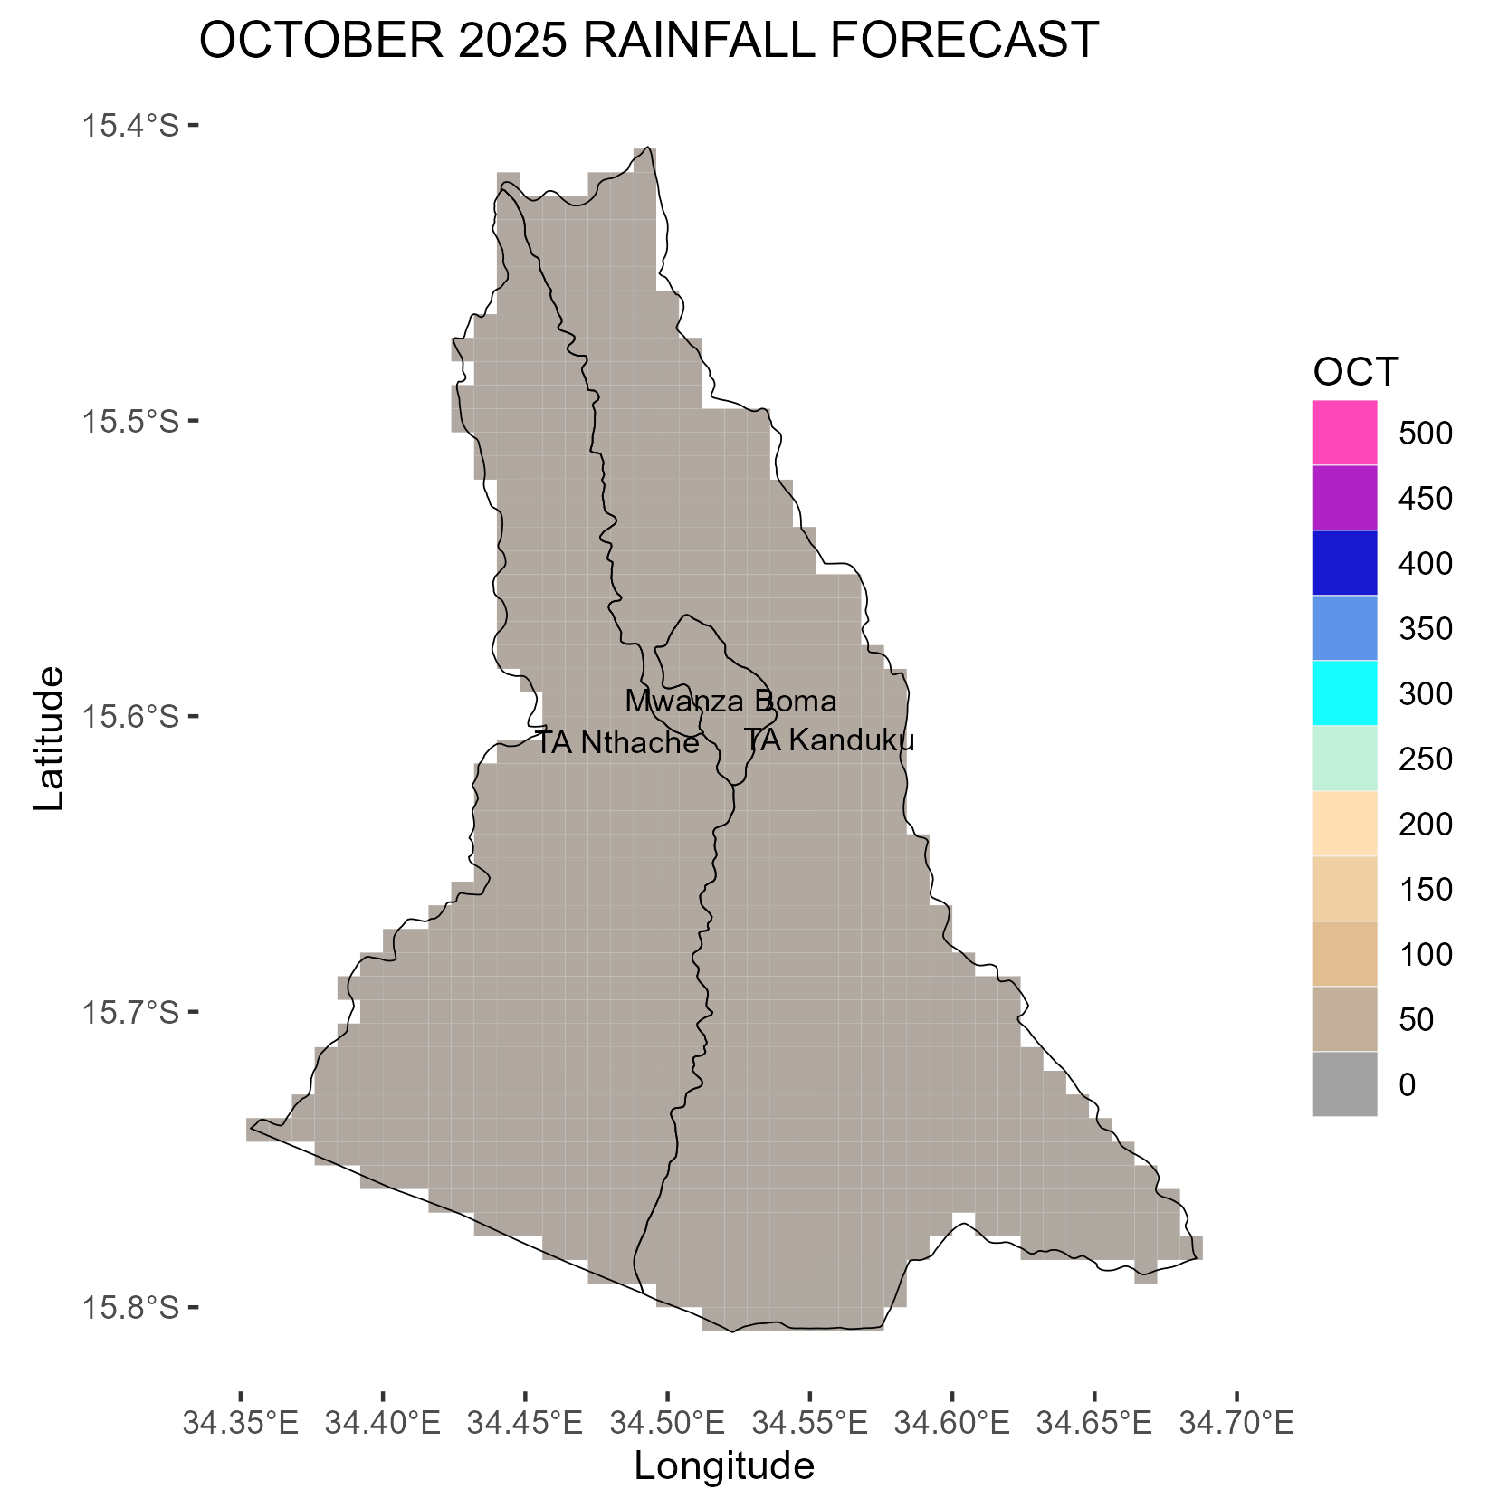
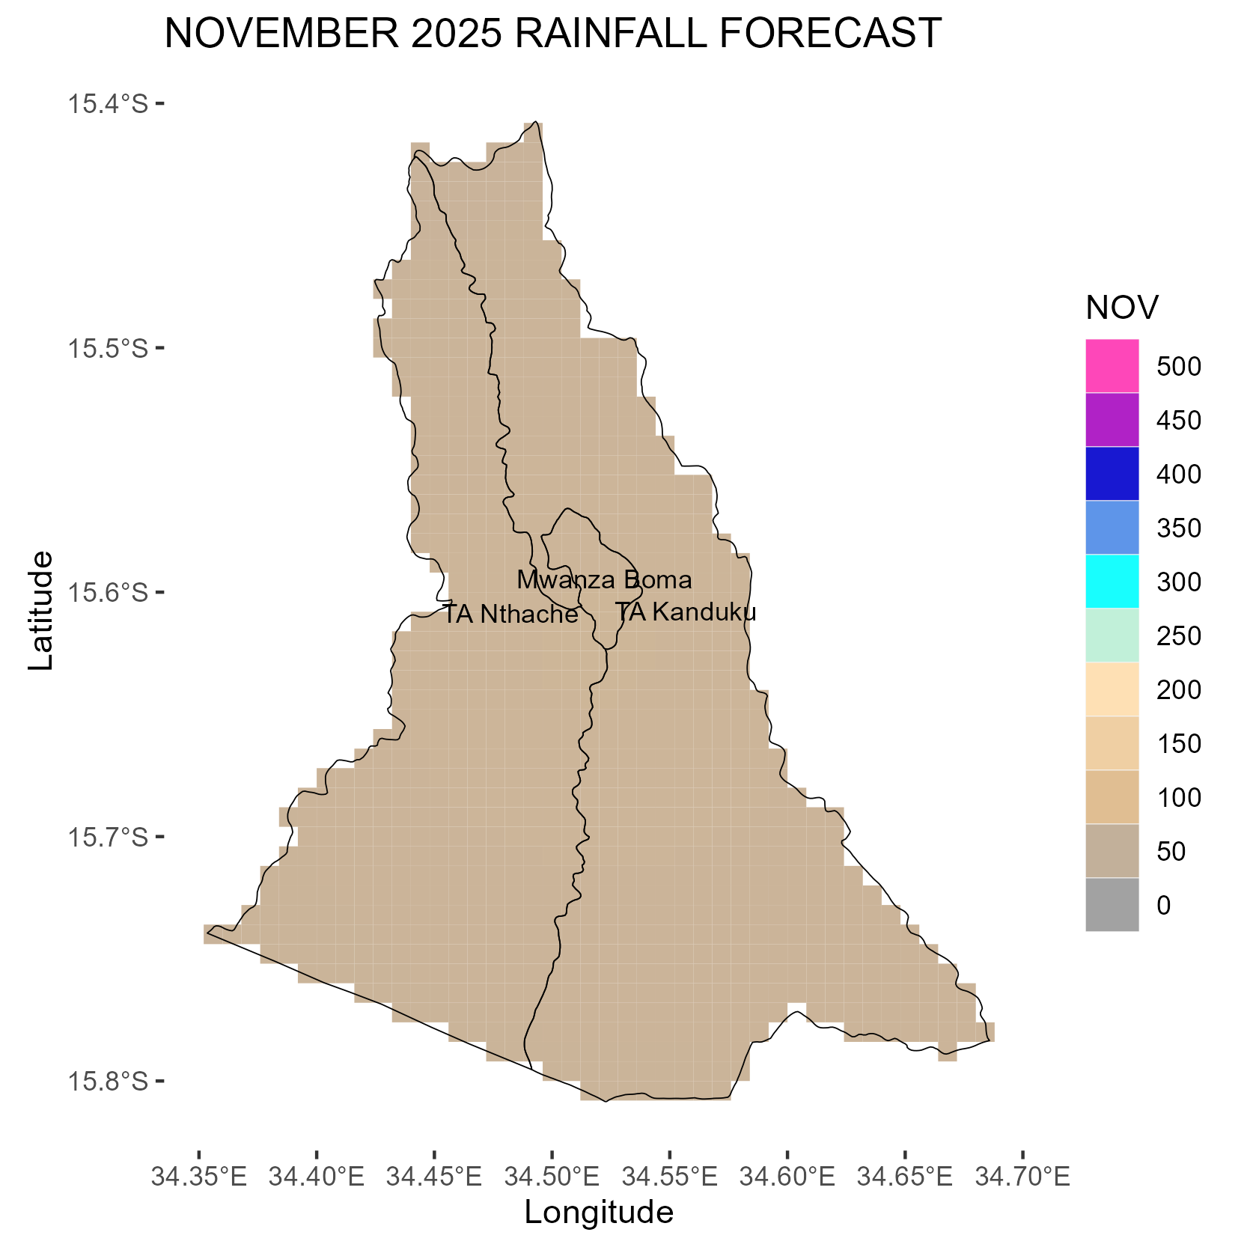
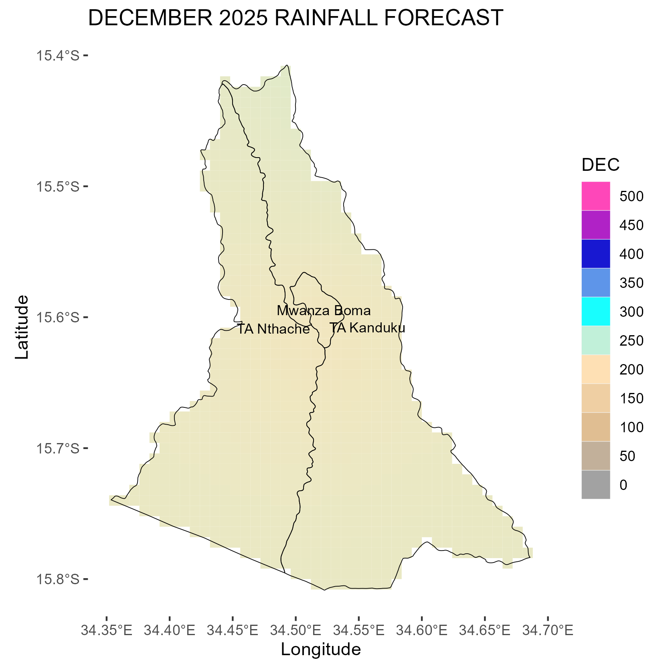
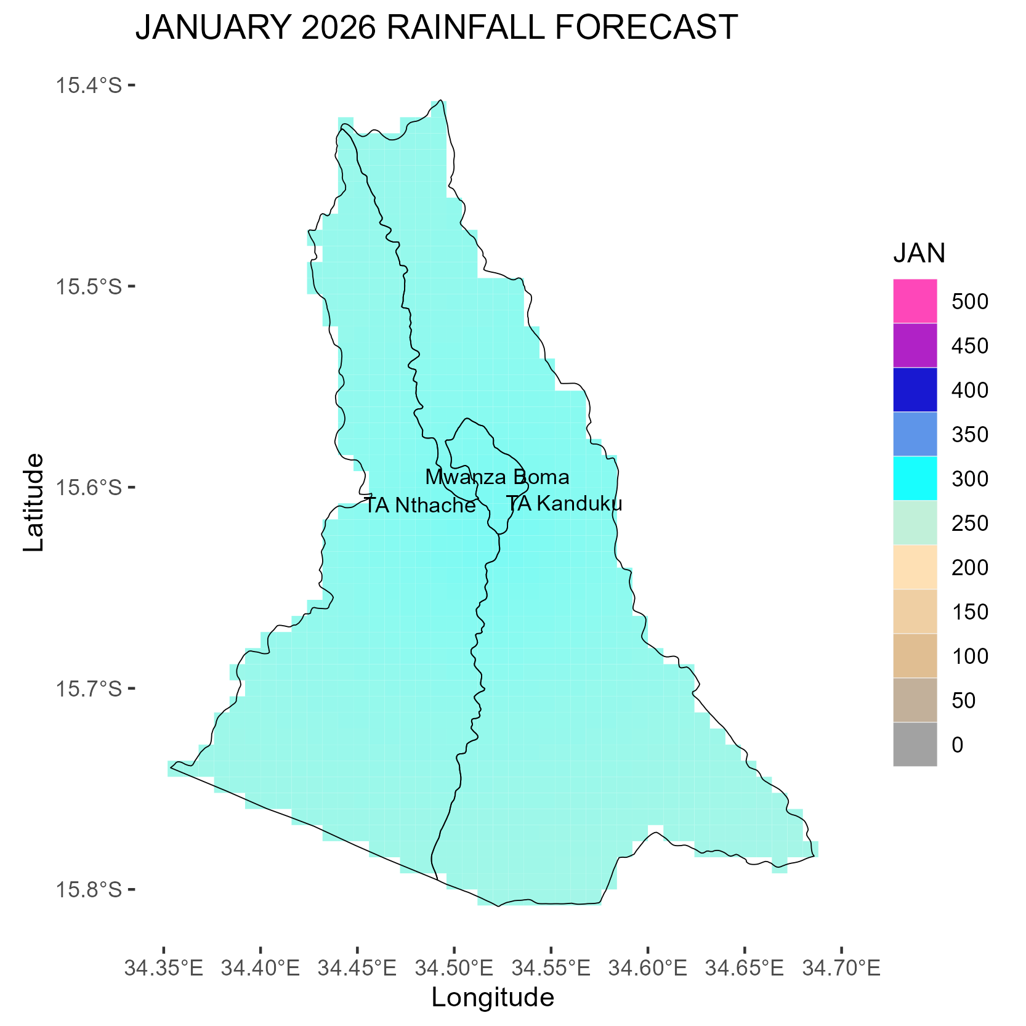
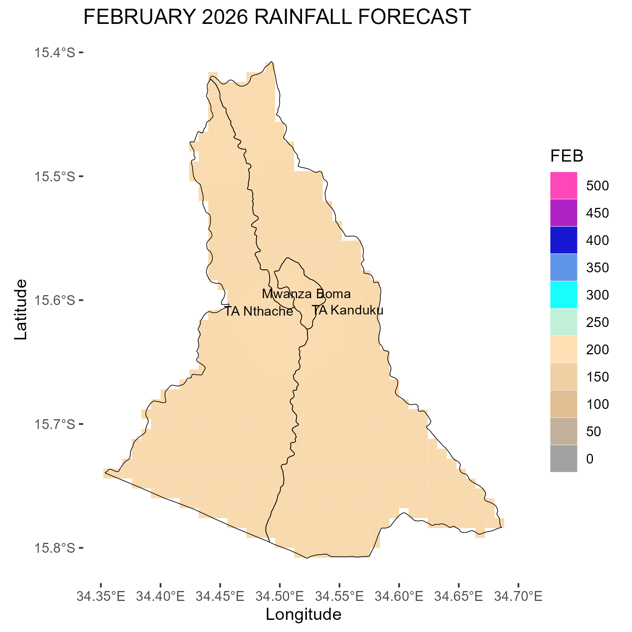
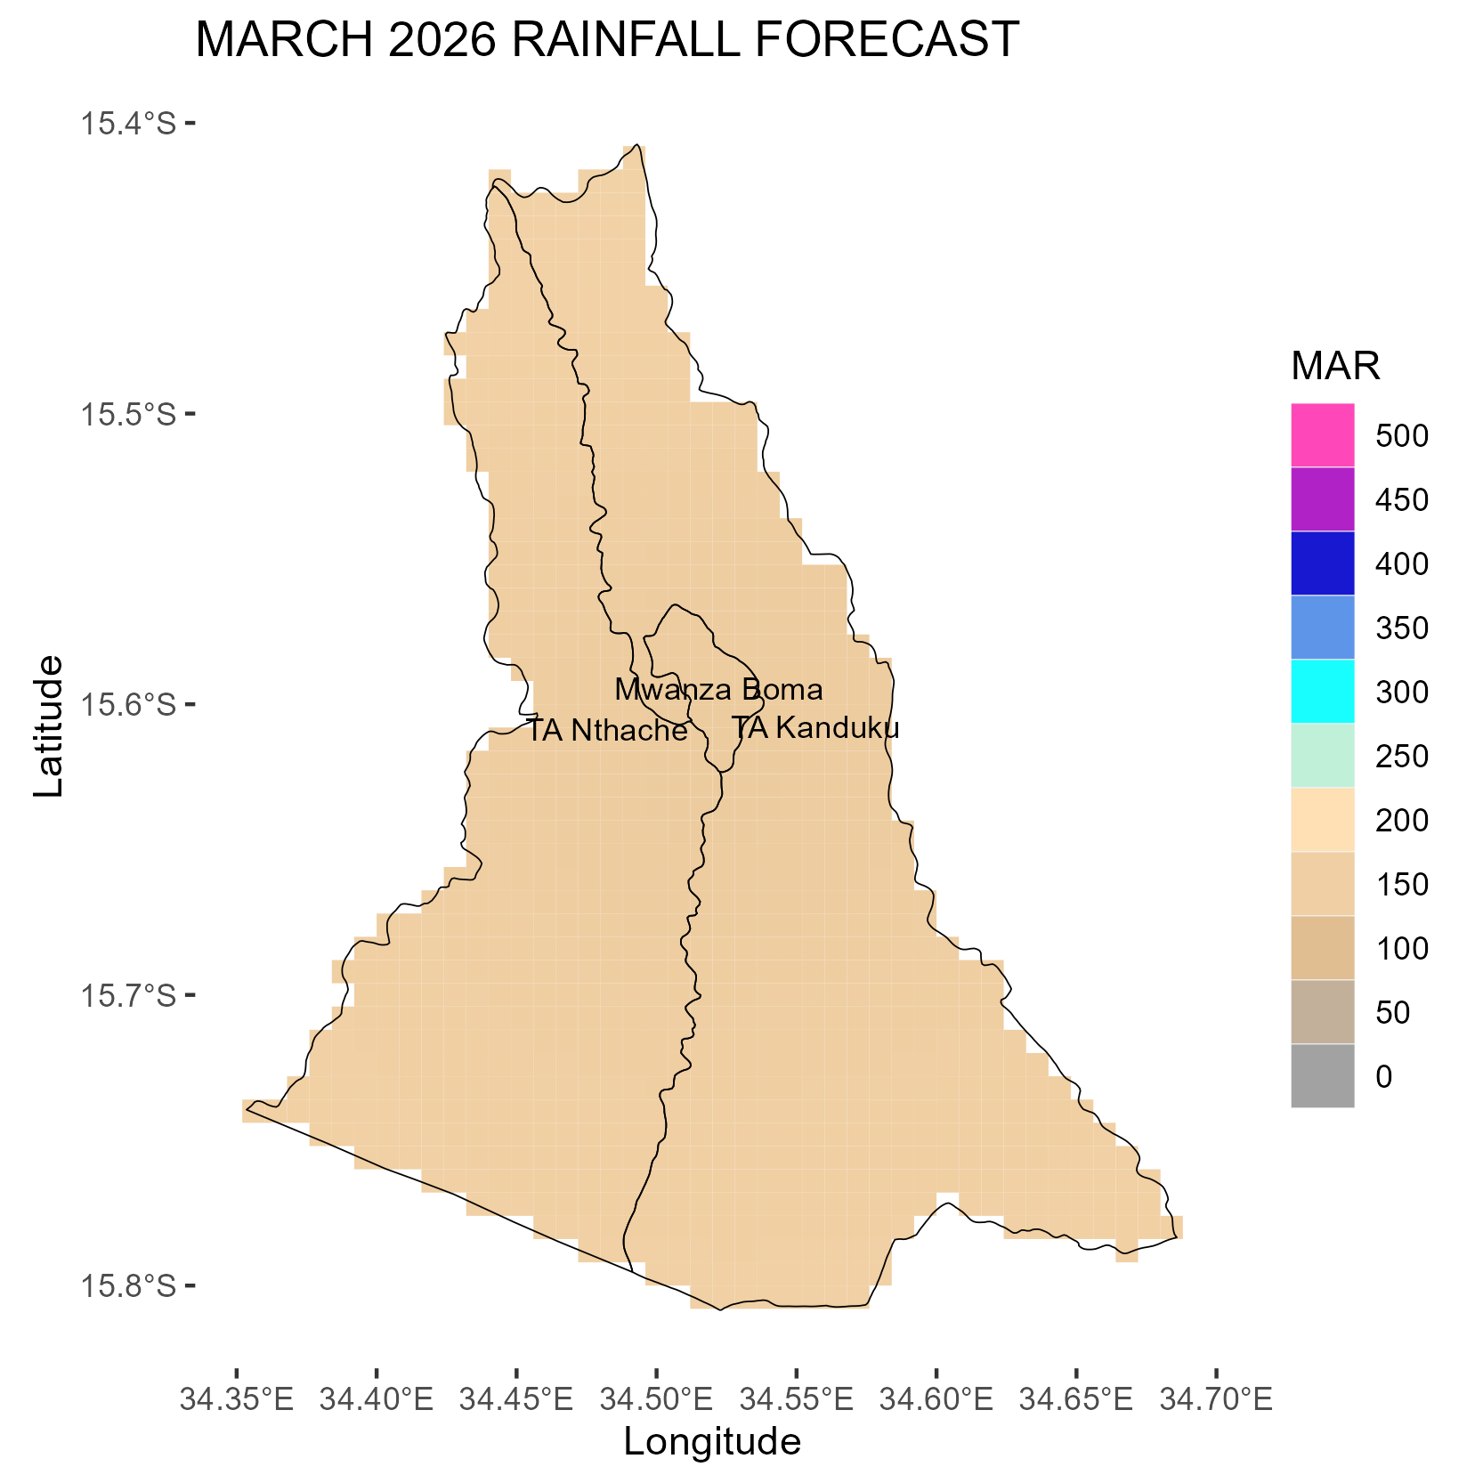

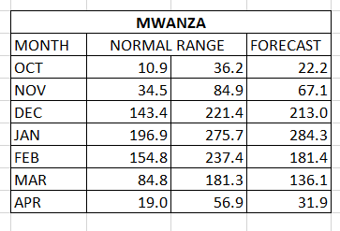
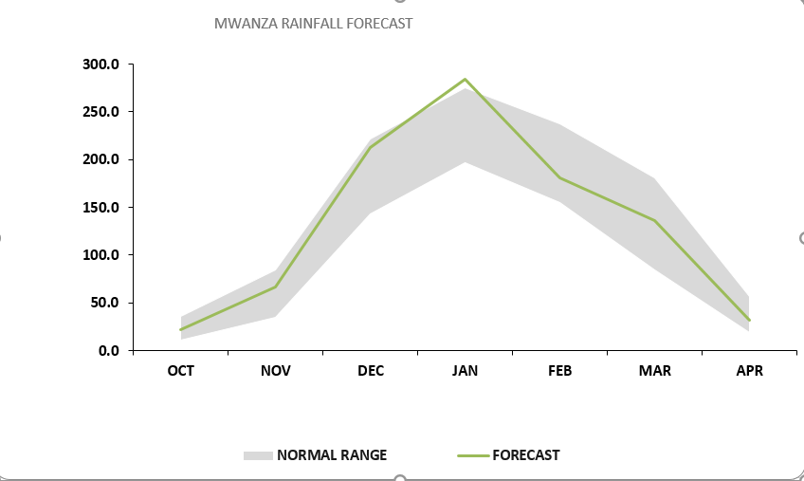
MINISTRY OF NATURAL RESOURCES AND CLIMATE CHANGE
DEPARTMENT OF CLIMATE CHANGE AND METEOROLOGICAL SERVICES
MWANZA DISTRICT DOWNSCALED SEASONAL FORECAST, 2025-2026
Overview of 2025/2026 Rainfall Season
The 2025-2026 rainfall season is likely to be partly influenced by Neutral El Nino Southern Oscillation conditions in the tropical pacific ocean among other factors.
Mwanza District is expected to receive generally normal rainfall amounts during the 2025/2026 rainfall season.
.
October 2025
November 2025
Mwanza district is expected to experience mostly dry conditions in October, with a few areas receiving rainfall of less than 20mm.
Expect Chizimalupsya rains to be accompanied by gusty winds and lightning.
In November, Rainfall amounts ranging from 50 to 100 mm accompanied by strong winds and lightning are anticipated in most areas .
December 2025
January 2026
In December, rainfall amounts between 200mm and 250mm are expected, in most parts of the district.
Most areas may experience their onset during the second week of this month.
In January, rainfall amounts are expected to be 300mm or more in most parts of the district.
One week dry spells are likely to during the month.
February 2026
March 2026
In February, most areas are expected to receive rainfall amounts ranging from 150 to 200mm.
Dry spells of about a week are likely during the month.
The district is expected to receive rainfall amounts ranging from 150mm to 200mm. during this month
April 2026
Rainfall onset is expected from mid December.
Cessation is expected last week of April.
The season is expected to span from 120 to 130 days.
Likelihood of dry spells of about a week in January and February.
The table and figure below show monthly rainfall distribution for the season with a normal band in grey.
April marks the end of the rainfall season in the district.
Most areas are expected to receive rainfall amount of less than 80mm during this month.
Rainfall cessation is expected from last week of April.
The forecast will be updated in December 2025
For further information contact: The Director of Climate Change and Meteorological Services, P.O. Box 1808,Blantyre.
Tel +265 1 82 47 12 / Cell: +265 882 26 65 79 Email: metdept@metmalawi.gov.mw ; Website: www.metmalawi.gov.mw
Produced and printed with support from:

