Slide 1


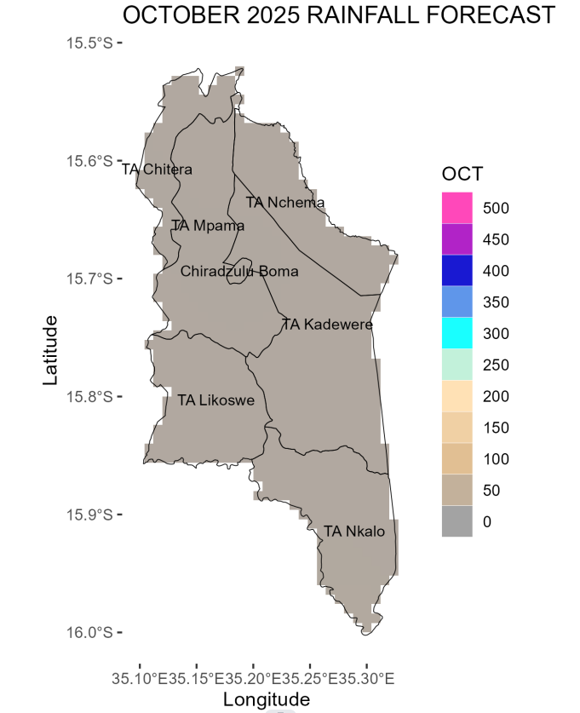
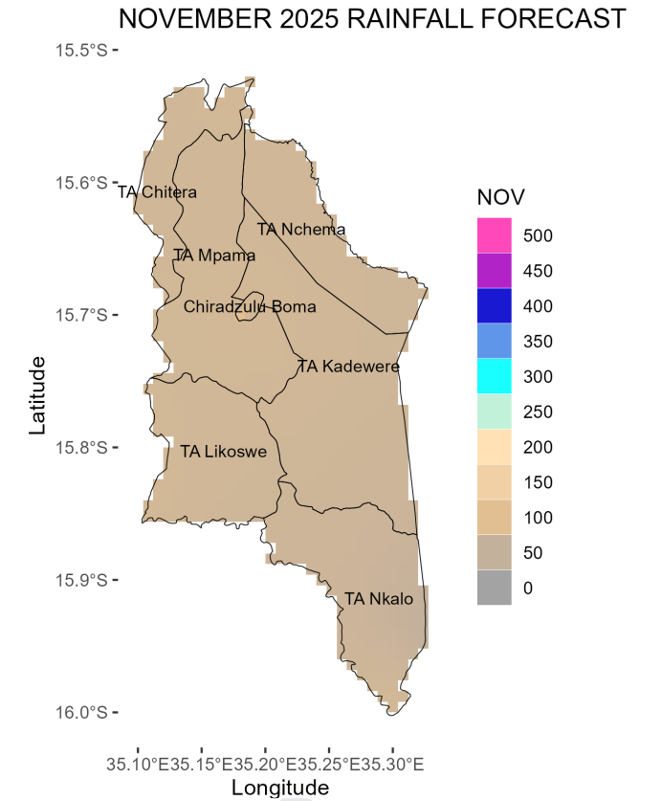
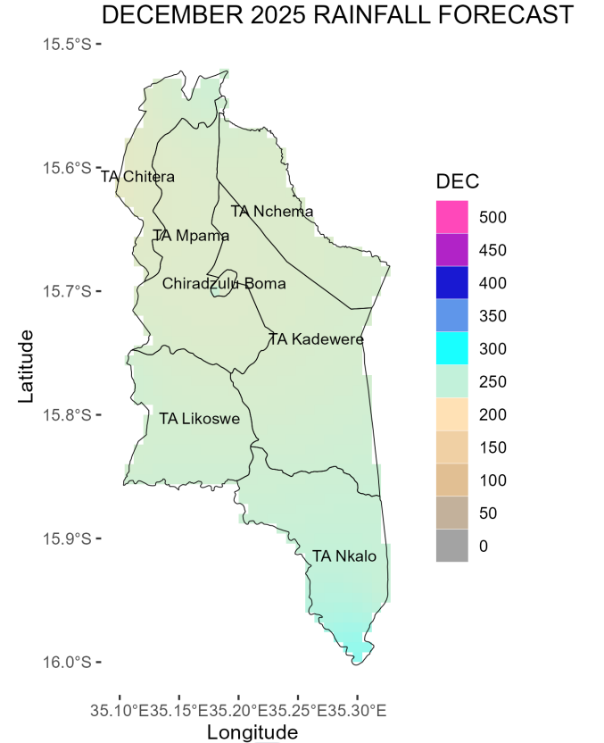
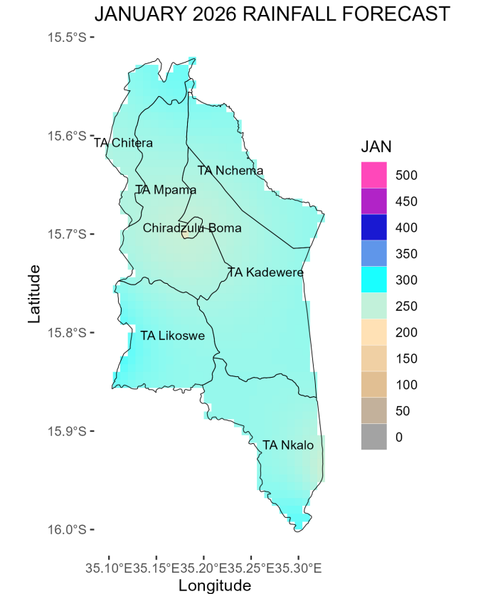
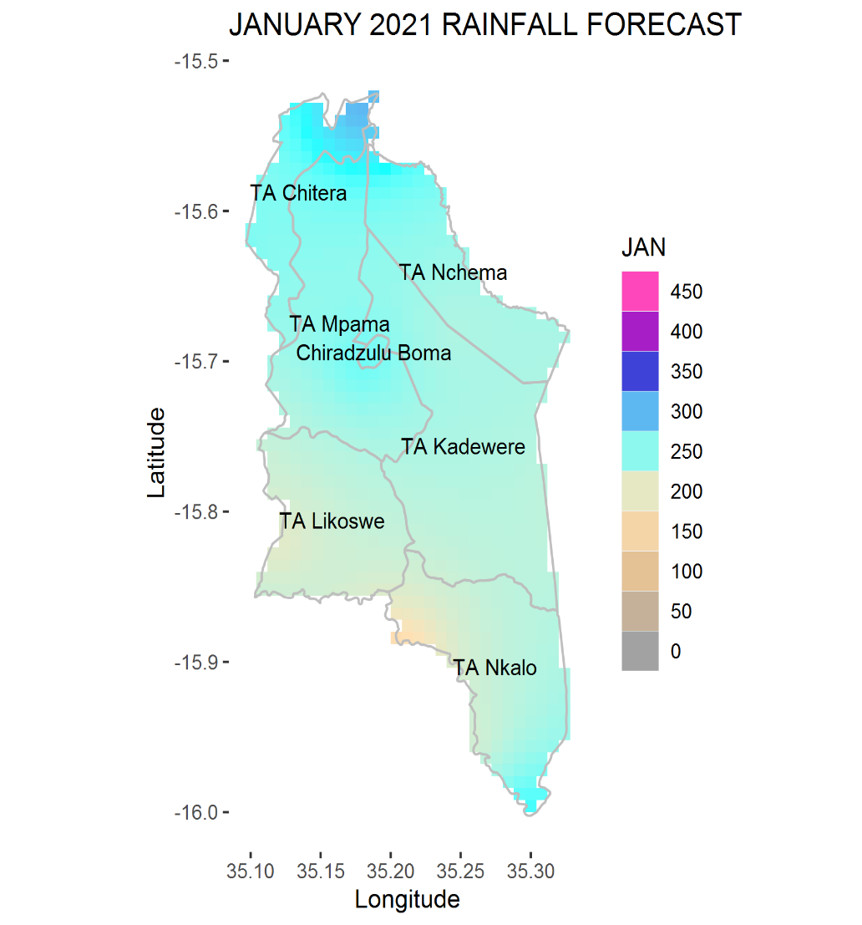
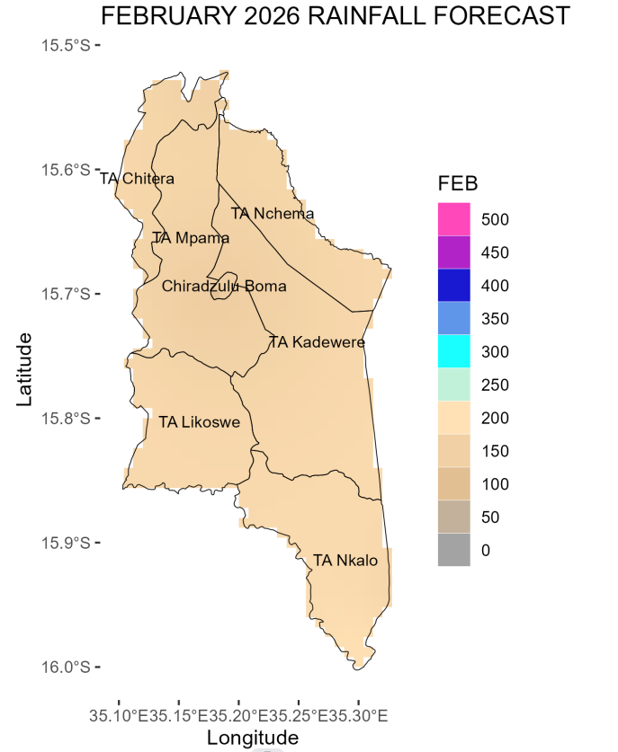
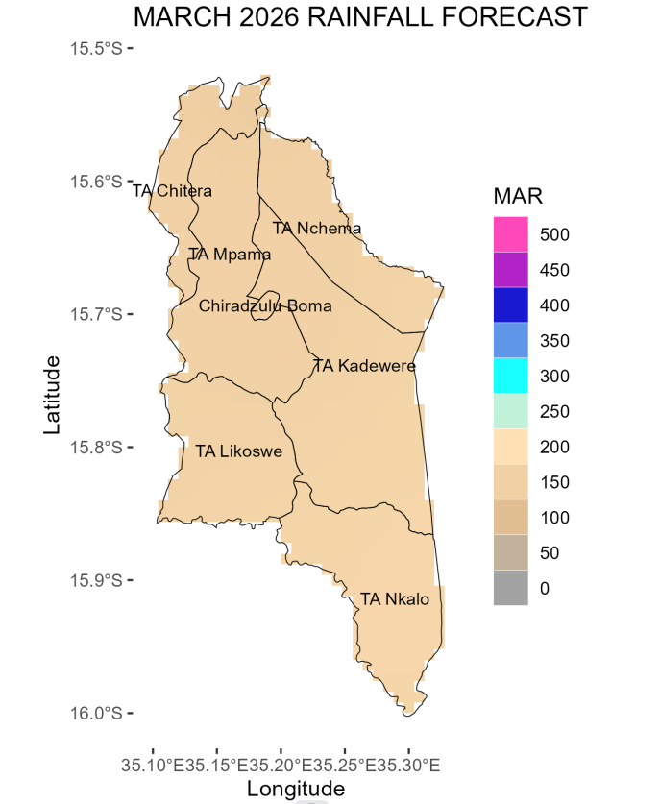
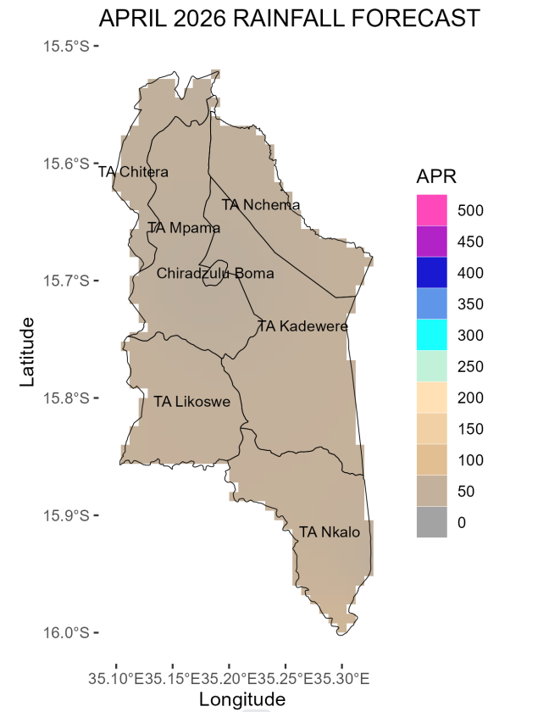
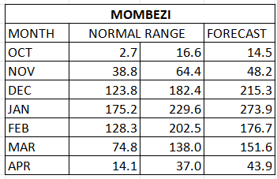
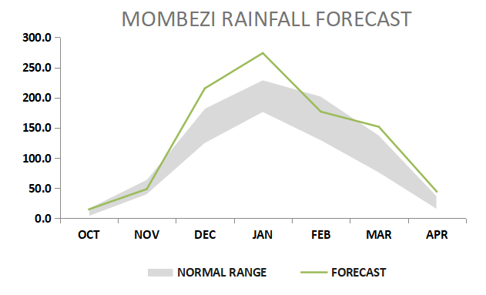
UNDUNA WA ZACHILENGEDWE NDI KUSINTHA KWA NYENGO
MINISTRY OF NATURAL RESOURCES AND CLIMATE CHANGE
NTHAMBI YOONA ZA NYENGO NDIKUSITHA KWA NYENGO
ULOSI WA KAGWEDWE KA MVULA M’DZINJA LA 2025-2026 M’BOMA LA CHIRADZULU
Overview of 2025/2026 Rainfall Season
Katenthedwe ka Nyanja ya mchere ya Pacific sikakhudza kwambiri nyengo ya dzinja ya 2025/26.
Mvula ya mulingo okhazikika komanso kuposera apo ikuyembekezereka m’boma la Chiradzulu makamaka mmadera akumpoto kwa bomali
October 2025
November 2025
Madera ambili ayembekezele kulandila mvula yasapitilila 50mm.
Tiyembekezele mvula ya chidzimalupsya ya mphepo yankuntho ndi mphezi m’mweziwu.
Mvula ya mlingo okhazikika kapena kuposela apo yapakati pa 50mm mpaka 100mm yikuyembekezeka mdelali, komabe, madela ena akuyembekezeka kulandila mvula yosapzola 50mm, womwe uli mlingo osakhazikika.
Mvula yokhazikika yaziphaliwali ikuyembekezeka m’sabata lachitatatu la mwezi wa November 2025.
December 2025
January 2026
Mvula ya mulingo wokhazikika kapena kuposera apo ya pakati pa 200 mpaka 250mm ikuyembekezeka mmadera ambiri abomali.
Madela ambiri akuyembekezeka kulandila mvula yoposa mulingo okhazikika, yapakati pa 250 mpaka 300mm mu mwezi wa January.
Pali chiyembekezo chachikulu chokhala ndi ng’amba yokwana sabata limodzi.
February 2026
March 2026
Mvula yamulingo okhazikika kapena kuchepela apo, ya pakati pa 150mm mpaka 200mm ikuyembekezeka m’mwezi wa February 2026 m’madela ambiri.
Pali kuthekera kokhala ndi ng’amba yokwana sabata limodzi.
Mvula ya pakati pa 150mm mpaka 200mm imene ili ya mlingo okhazikika kapena kuposera apo ikuyembekezeka m’mwezi wa March.
April 2026
Mvula yokhazikika ikuyembekezeka kuyamba kugwa kuchokera mu sabata la lachitatu la mwezi wa November 2025.
Nyengo yadzinja ikuyembekezeka kupita kumapeto kuyambila sabata lachitatu la mwezi wa April 2025.
Miyezi ya January ndi February yikuyembekezeka kukhala ndi ng’amba ya sabata imodzi.
Nyengo ya dzinja lonse likuyembekezeka kukhala yalitali ndi masiku apakati pa 130 mpaka 140.
Chithunzi chili mmusimu chikusonyeza ulosi wakagwedwe kamvula poyerekeza ndi mulingo okhazikiza.
Mmadera ambiri ayembekezere kulandira mvula yamulingo okhazikika komanso kuposera apo ya cha mma 50mm.
Mvula ikuyembekezera kudzatha chamkati mwa mwezi wa April
The forecast will be updated in December 2024
For further information contact: The Director of Climate Change and Meteorological Services, P.O. Box 1808,Blantyre.
Tel +265 1 82 47 12 / Cell: +265 882 26 65 79 Email: metdept@metmalawi.gov.mw ; Website: www.metmalawi.gov.mw
Yotulutsidwa ndi kusindikizidwa ndi thandizo lochokera ku:
Notes:
‹#›

