Slide 1


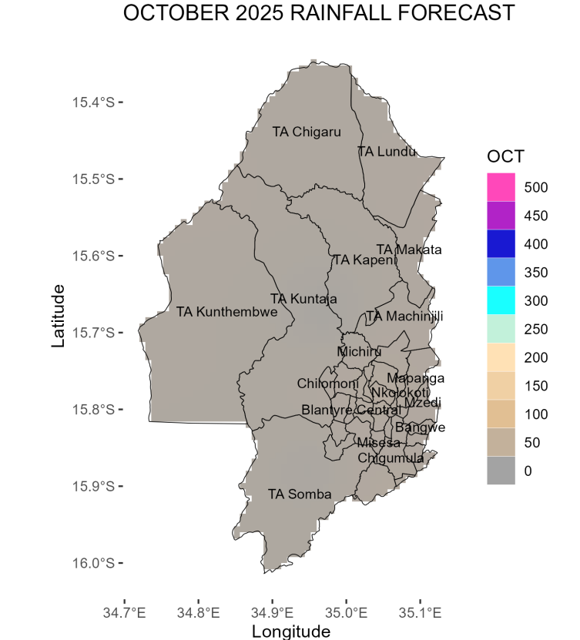
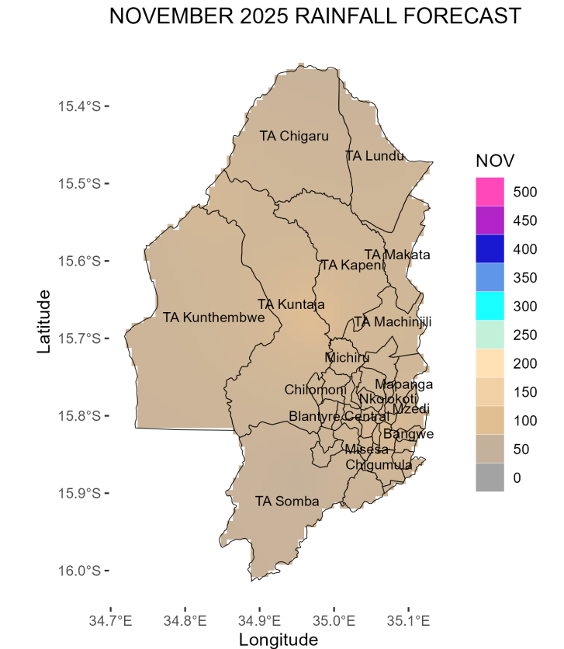
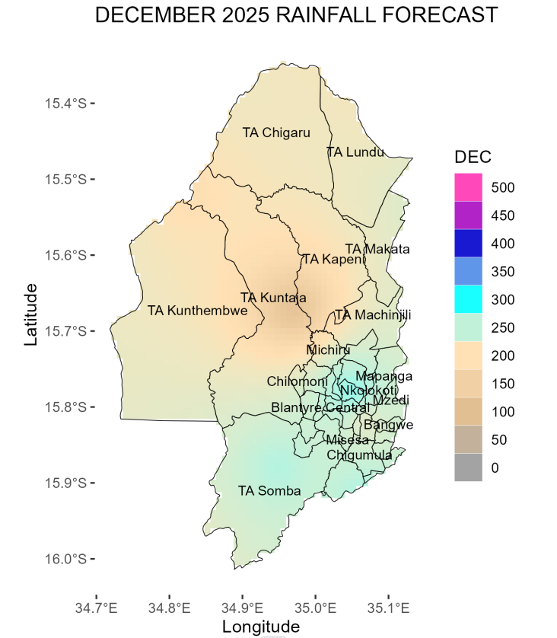
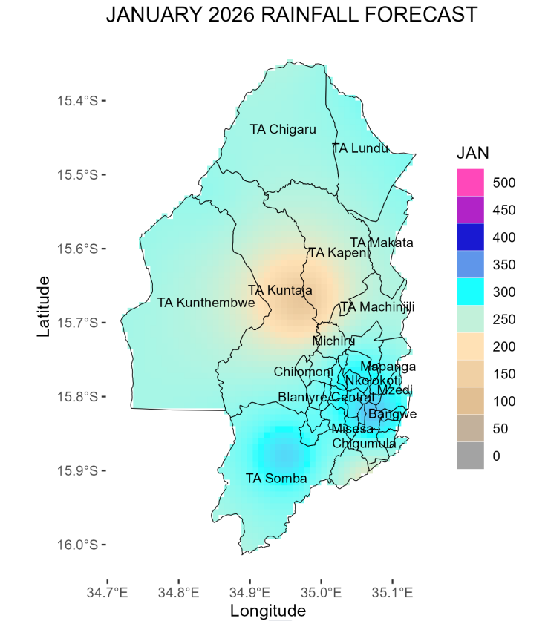
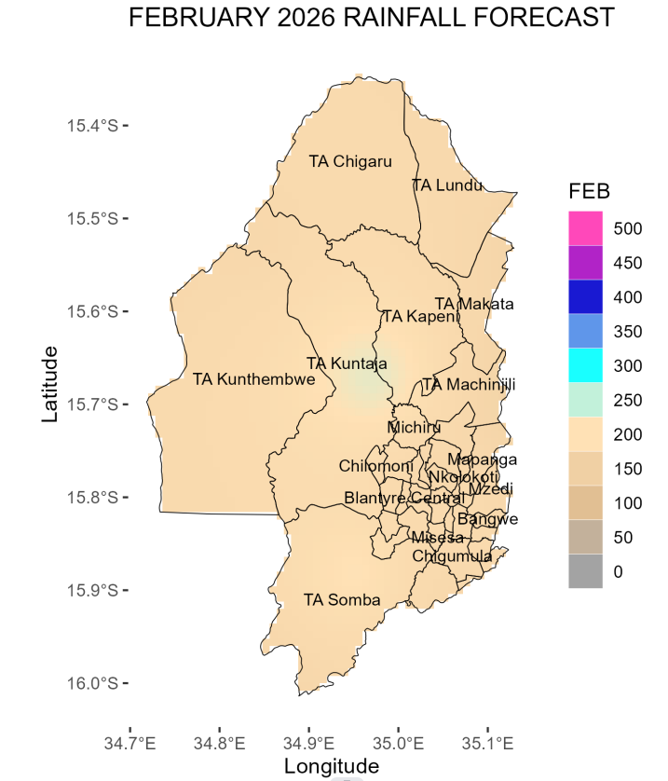
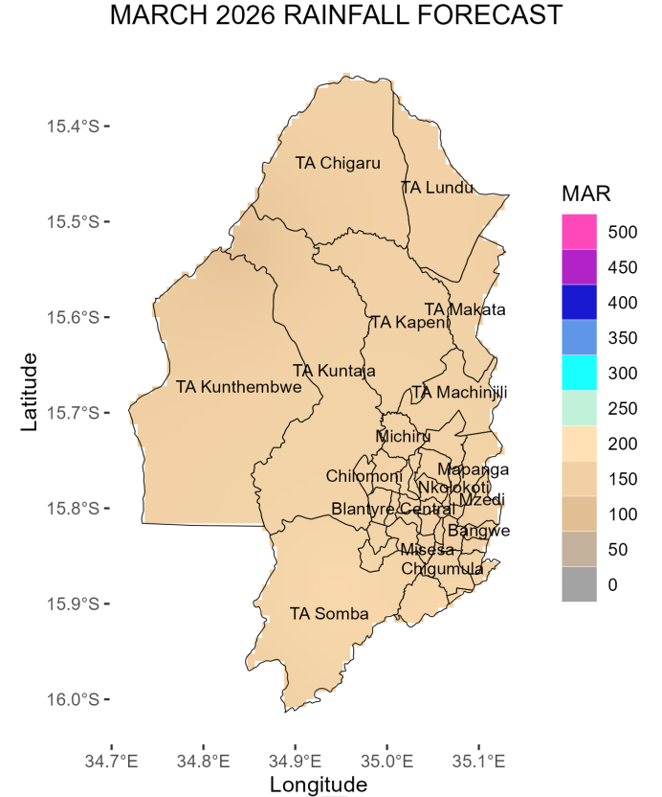
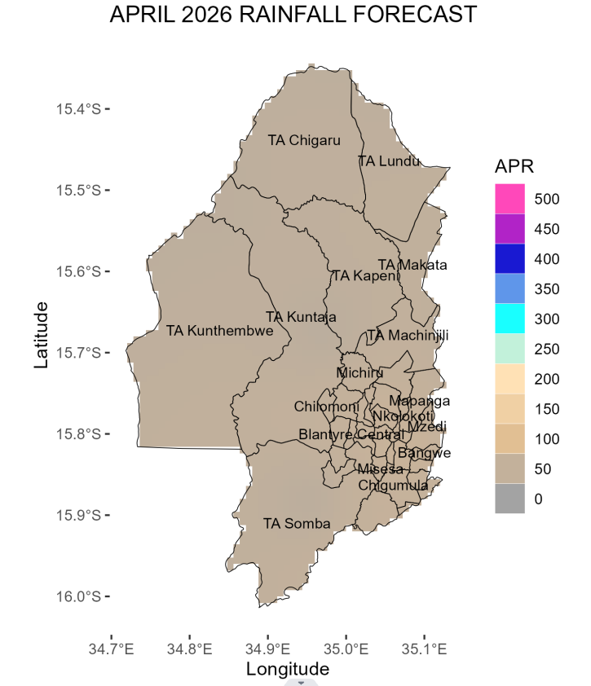
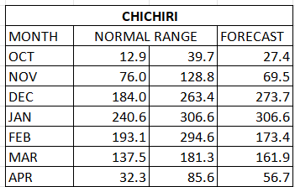
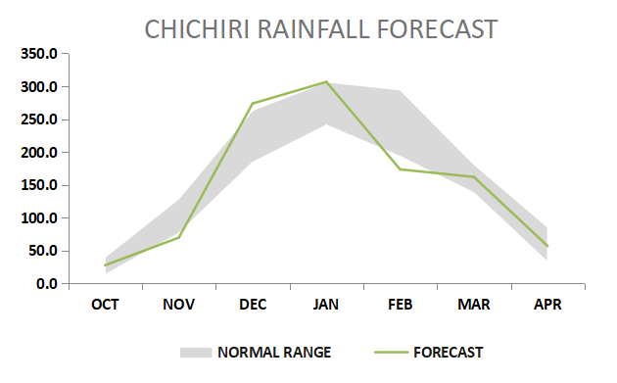
MINISTRY OF NATURAL RESOURCES AND CLIMATE CHANGE
DEPARTMENT OF CLIMATE CHANGE AND METEOROLOGICAL SERVICES
BLANTYRE DISTRICT DOWNSCALED SEASONAL FORECAST, 2025-2026
Overview of 2025/2026 Rainfall Season
The 2025/2026 rainfall season is likely to be partly influenced by Neutral El Nino Southern Oscillation conditions in the tropical Pacific Ocean among other factors.
Blantyre district is expected to receive normal to above normal total rainfall amounts from October to April 2026. However, there is high likelihood of normal to below normal rainfall in the months of November and February.
October 2025
November 2025
October is expected to be hot and dry with a chance of Chizimalupya rains. These rains may be accompanied by lightning and gusty winds.
During the month of November Normal to below-normal rainfall amounts are expected over most parts of the district with onset rains anticipated from mid November
Expect the rains to be accompanied by gusty winds and lightning.
December 2025
January 2026
During December, rainfall amounts ranging from 100mm to 200mm are expected over TA Kuntaja, TA Kapeni, TA Kunthembwe, TA Chigalu, and TA Lundu. Blantyre City and TA Somba are likely to receive up to 250 mm of rainfall.
These anticipated amounts generally fall within the normal to above-normal range for the district during this month.
Normal to above-normal rainfall amounts ranging from 250mm to 300mm are expected in most parts of Blantyre.
However, areas around TA Kuntaja and the southeast of TA Kapeni are projected to receive normal to below-normal rainfall, ranging from 100mm to 200mm.
There is a high likelihood of dry spell of about a week.
February 2026
March 2026
Normal to below normal rainfall amounts in the range of 150 mm to 200mm are anticipated over most areas of the district .
There is a high likelihood of a dry spell lasting for about a week.
Rainfall amounts ranging from 100mm to 150mm are expected in most areas of the district
The anticipated amounts are within the normal to above normal category.
April 2026
Rainfall onset is anticipated from Mid November 2025.
Cessation is expected from mid April 2026.
The seasonal length between 130 and 140 days.
A dry spell of about seven days is possible in January and February 2026
In April 2026, the district is expected to receive between 50mm and 100mm of rainfall, which falls within the normal to above-normal range.
Rainfall cessation is expected from mid April.
The table and figure below show monthly rainfall distribution for the season with a normal band in grey.
The forecast will be updated in December 2024
For further information contact: The Director of Climate Change and Meteorological Services, P.O. Box 1808,Blantyre.
Tel +265 1 82 47 12 / Cell: +265 882 26 65 79 Email: metdept@metmalawi.gov.mw ; Website: www.metmalawi.gov.mw
Produced and printed with support from:

