Slide 1


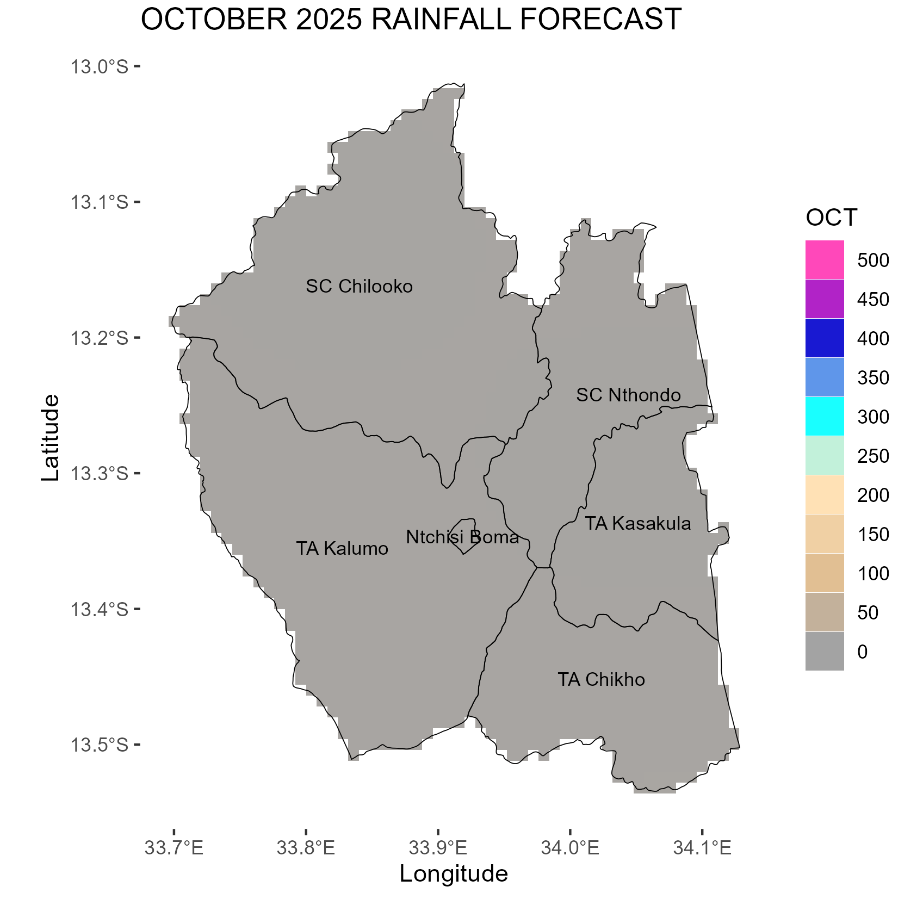
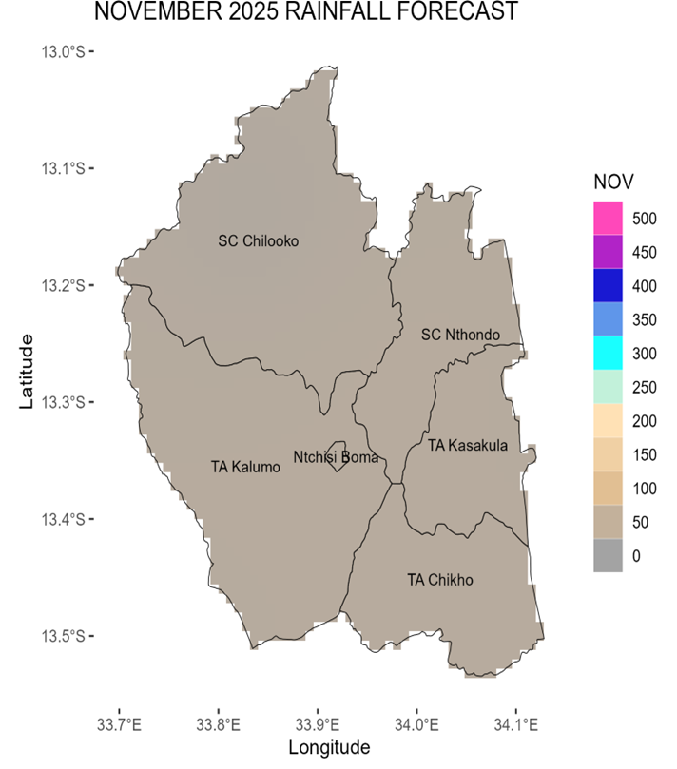
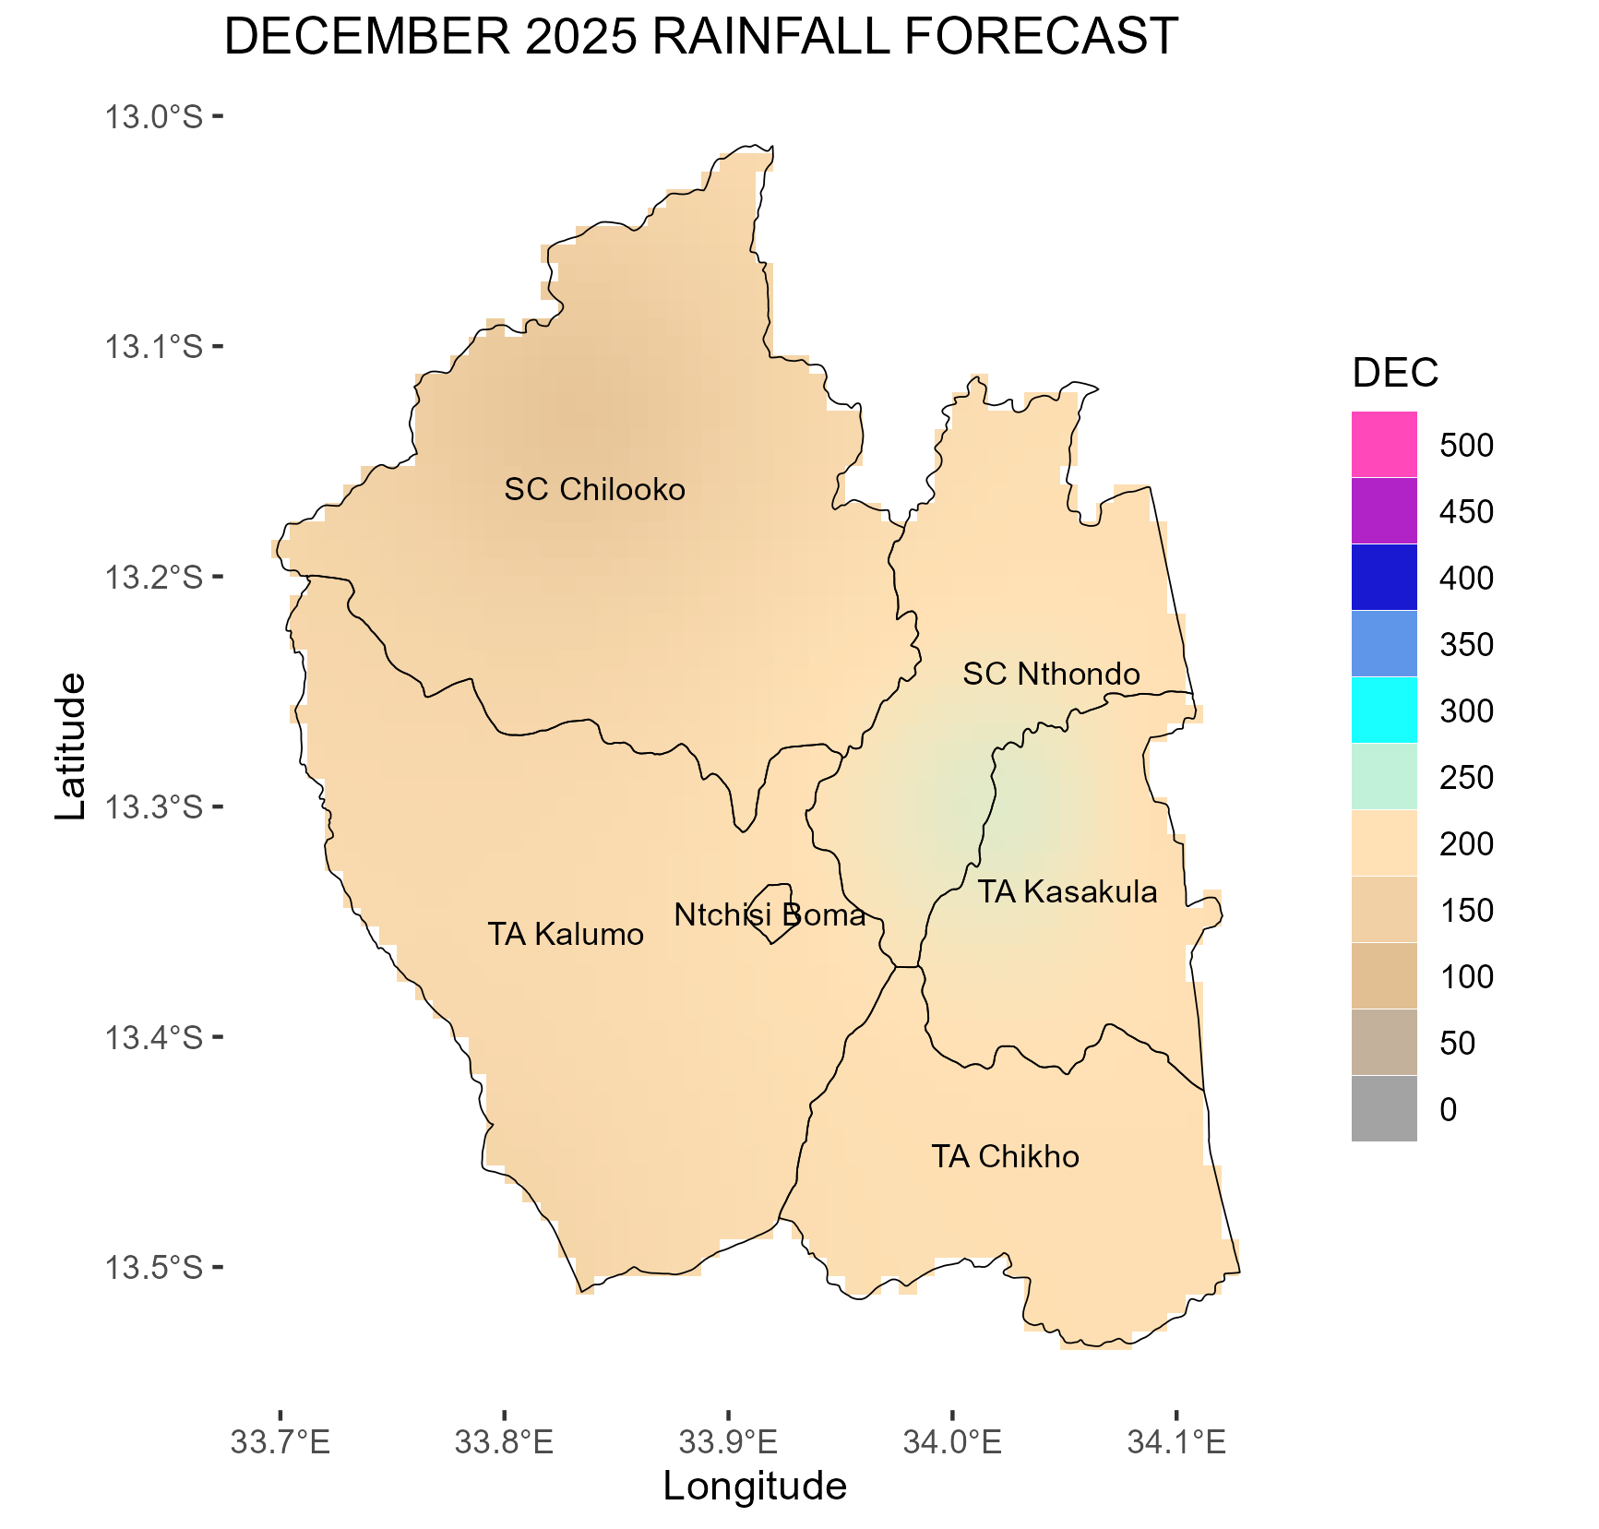
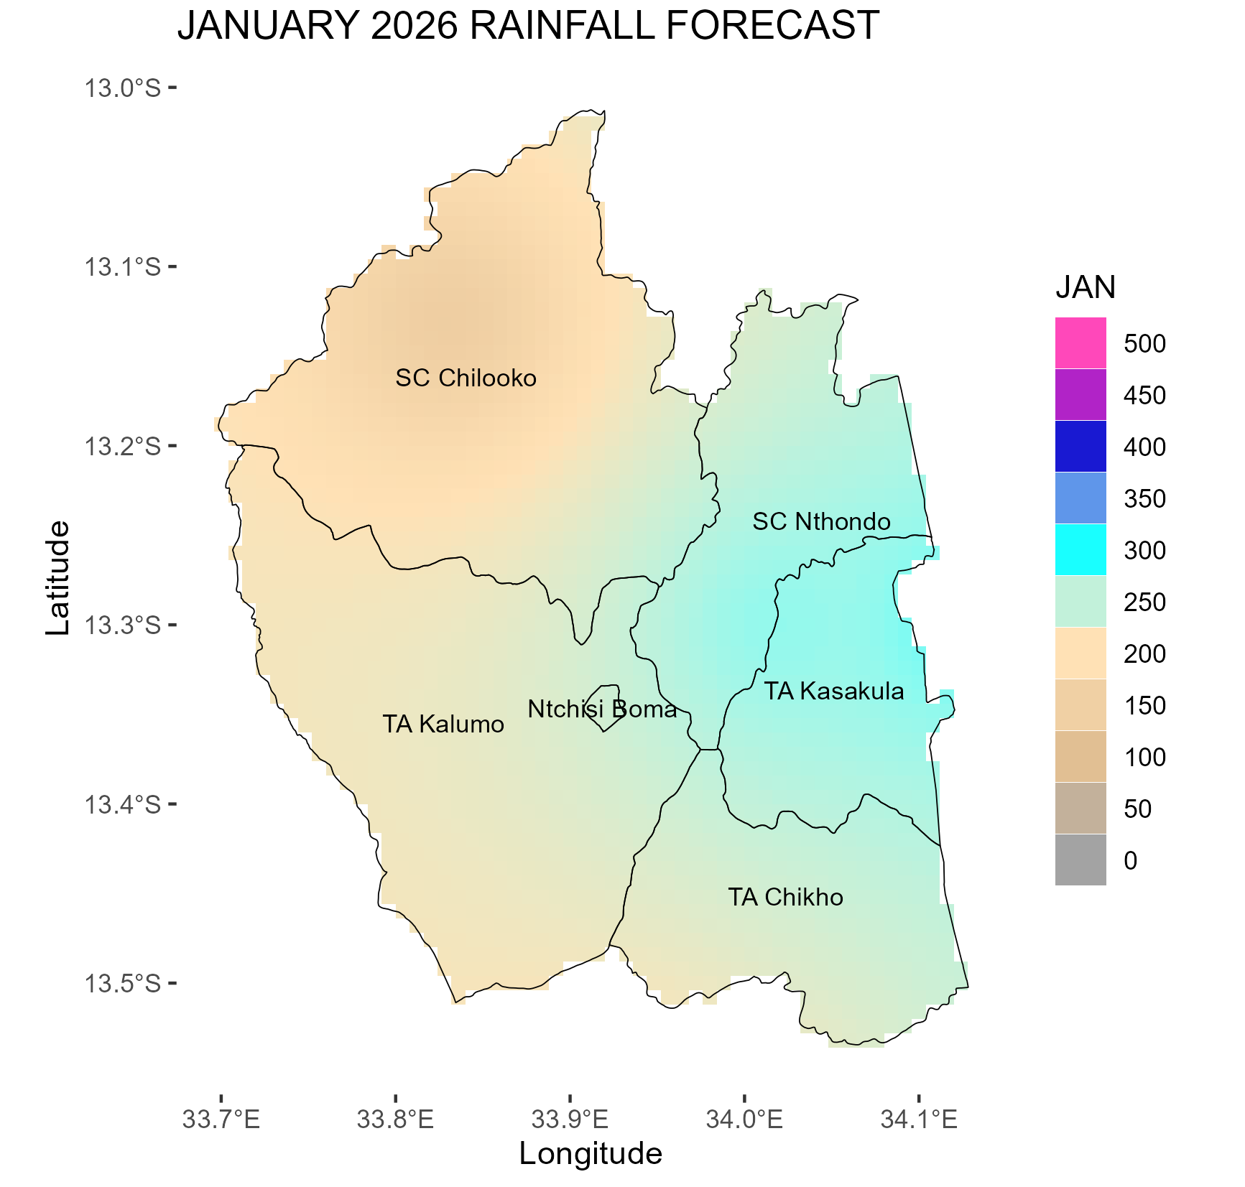
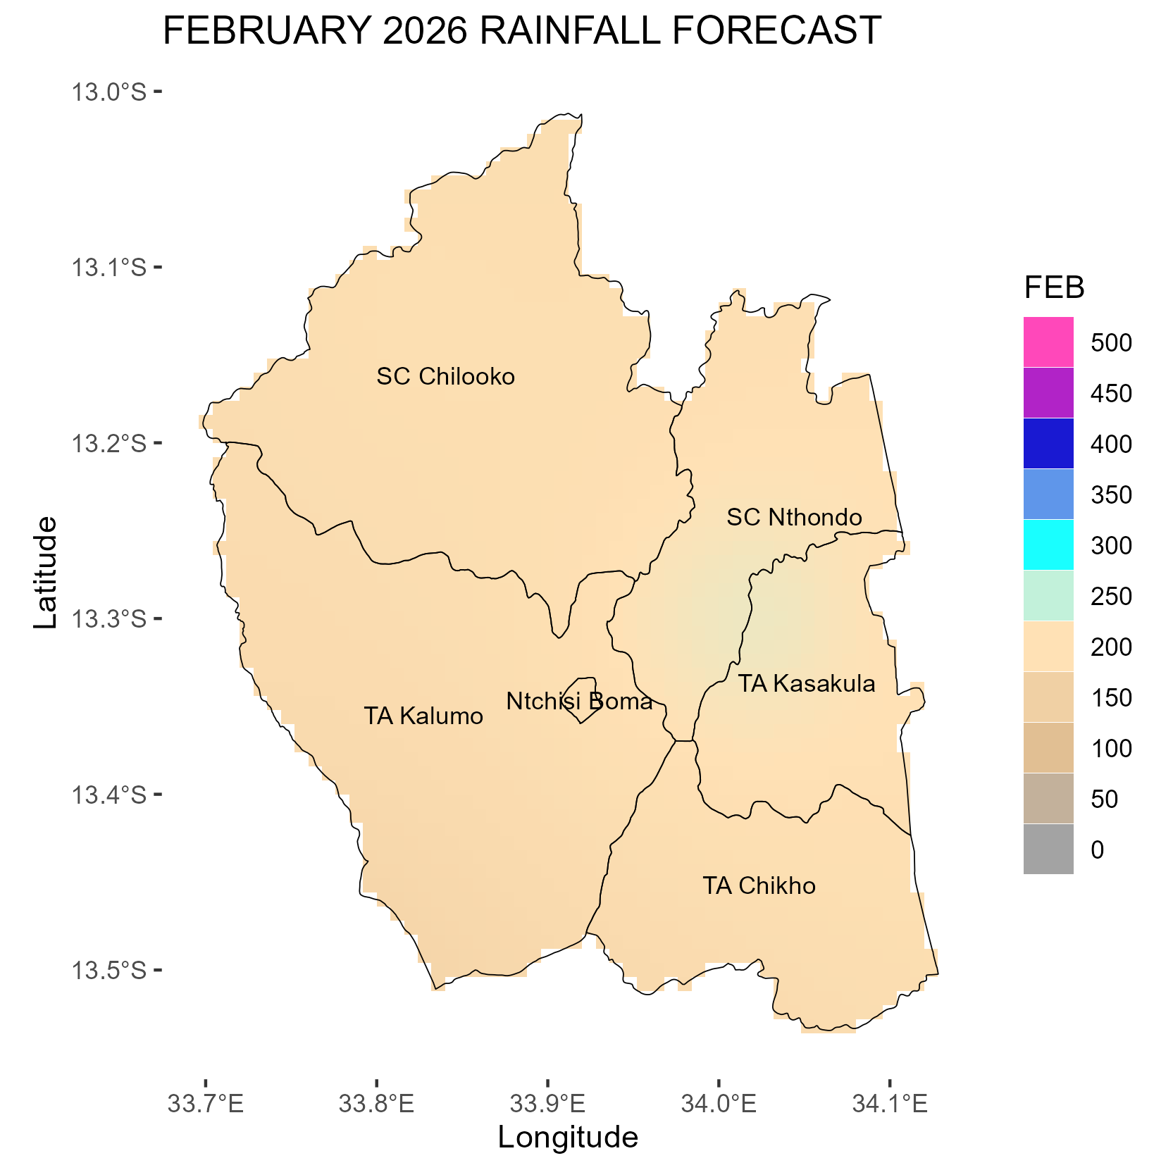
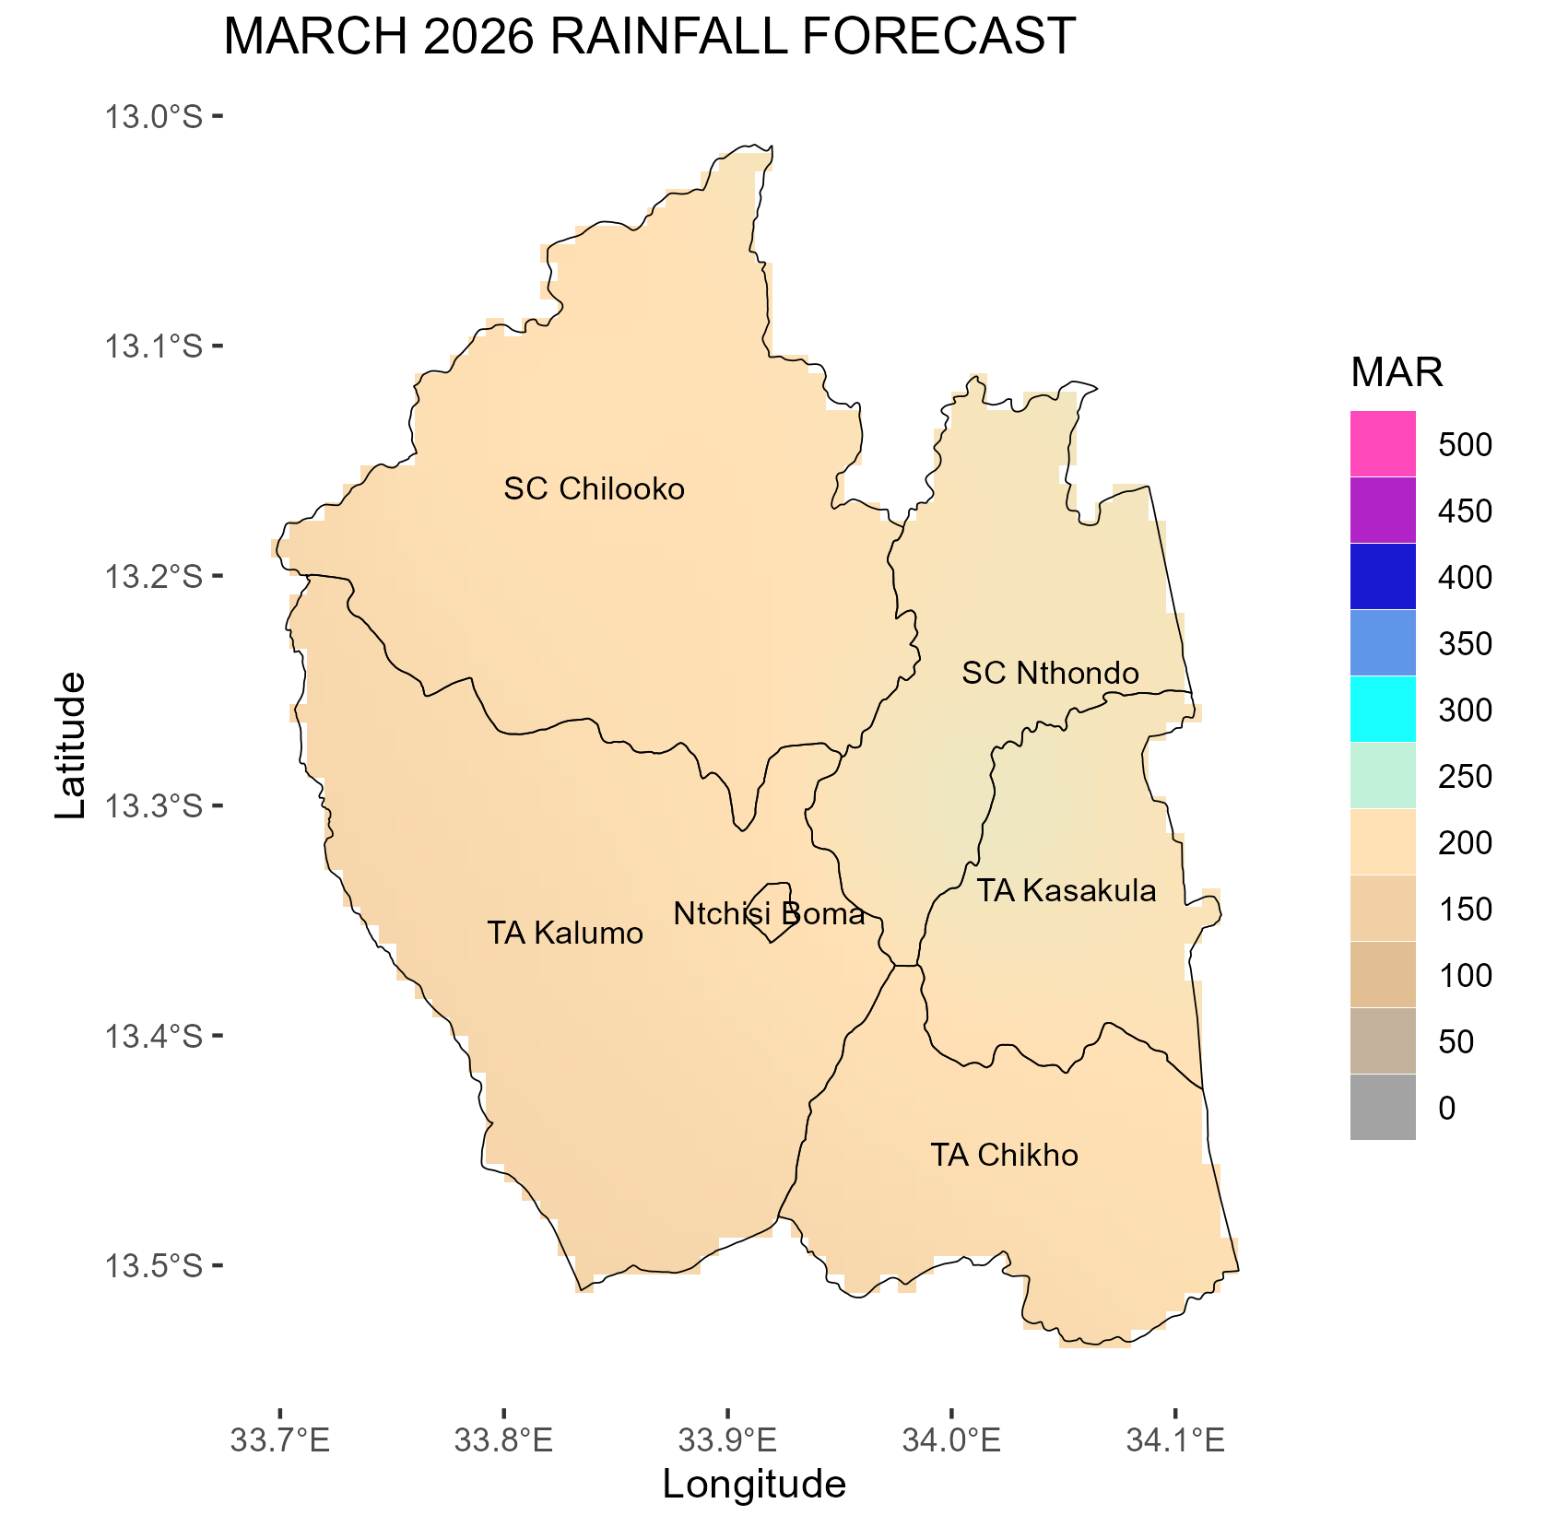
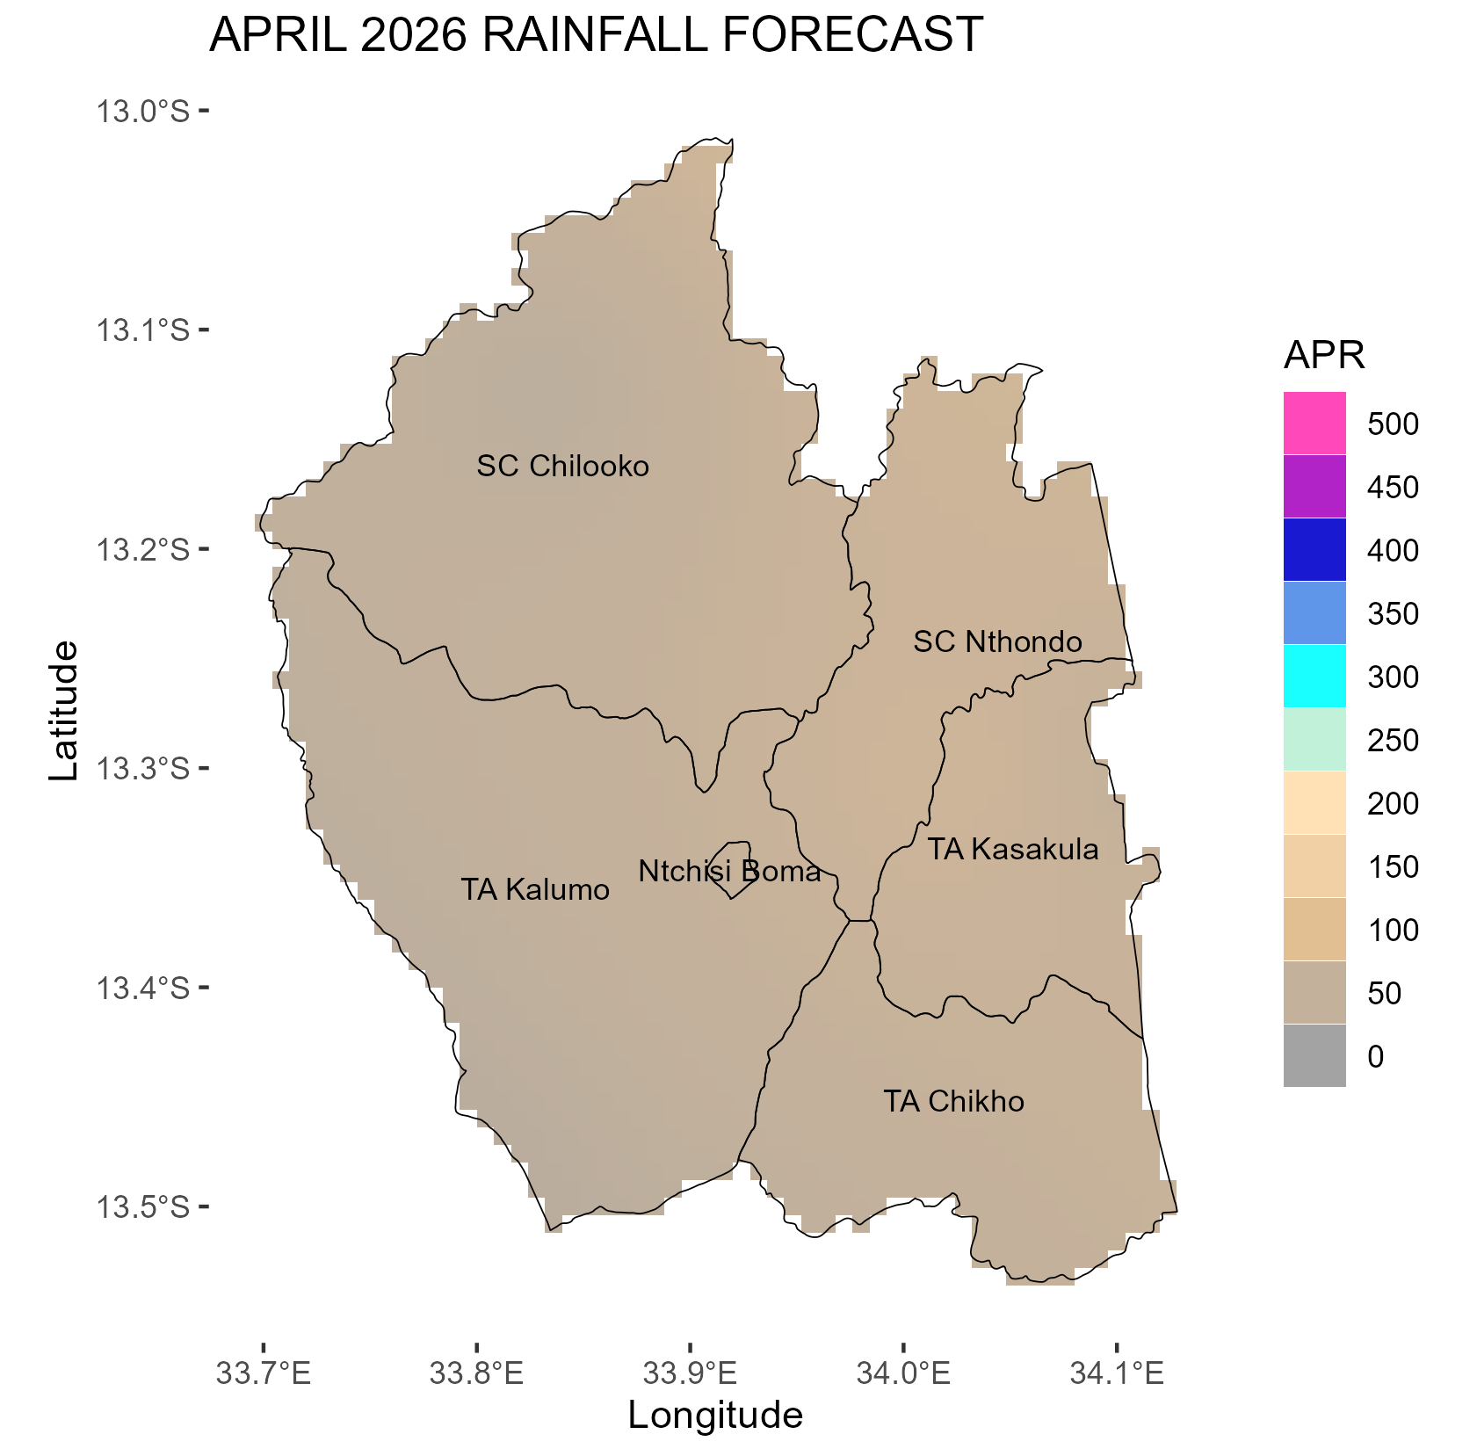
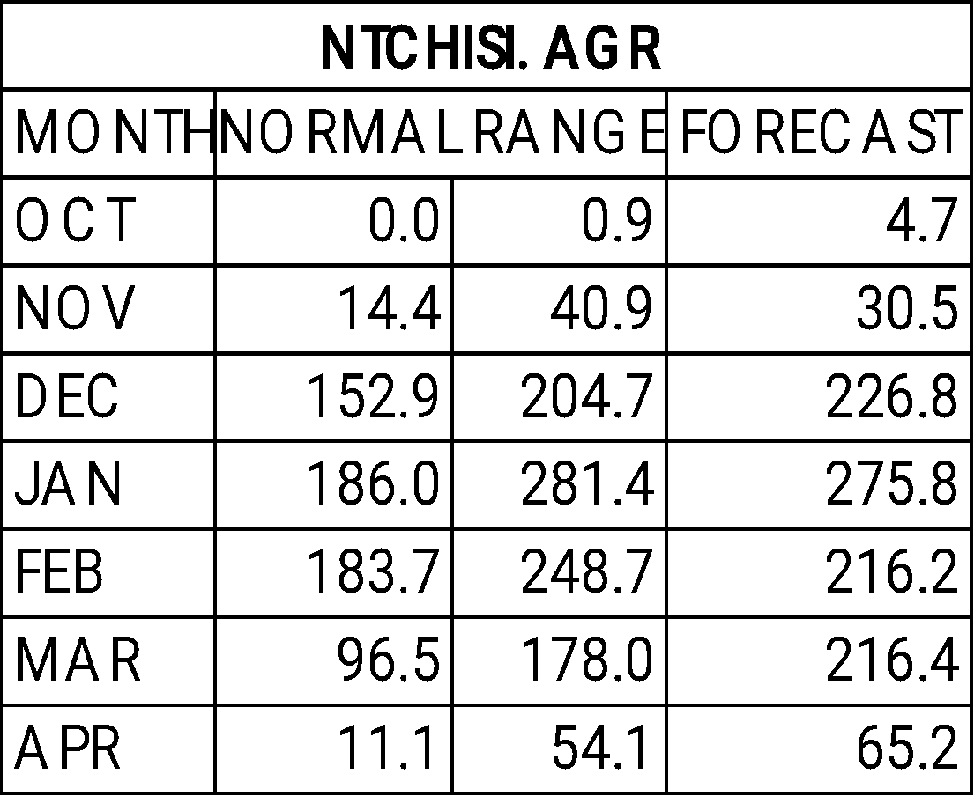
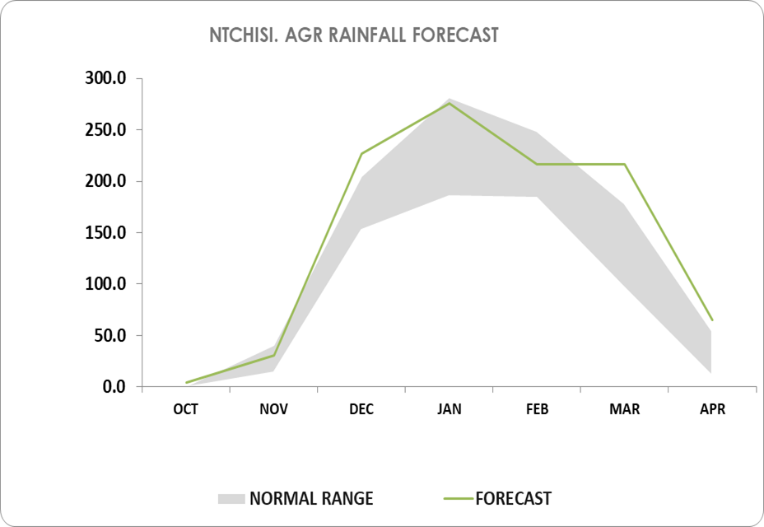
MINISTRY OF NATURAL RESOURCES AND CLIMATE CHANGE
DEPARTMENT OF CLIMATE CHANGE AND METEOROLOGICAL SERVICES
NTCHISI DISTRICT DOWNSCALED SEASONAL FORECAST, 2025-2026
OVERVIEW OF 2025/2026 RAINFALL SEASON
The 2025/2026 rainfall season is likely to be partly influenced by Neutral El Nino Southern Oscillation conditions in the tropical Pacific Ocean among other factors.
Ntchisi District is expected to receive generally normal to above normal rainfall amounts during the 2025/2026 rainfall season.
October 2025
November 2025
During this month, certain areas of Ntchisi District may record rainfall amounts below 50 mm, while the greater part of the district is expected to remain predominantly dry with no significant precipitation.
In addition, strong and gusty winds are anticipated during this period.
In November, most areas of the district are forecast to receive less than 50 mm of rainfall.
The period is further expected to be characterized by gusty winds and occurrences of lightning.
December 2025
January 2026
The onset of the rainy season is expected around mid-December 2025.
In December, most parts of the district are forecast to receive between 100 mm and 150 mm of rainfall. However, areas around SC Nthondo and sections of TA Kasakula in the northwest are projected to record approximately 250 mm.
This period is also likely to be characterized by occurrences of lightning and strong winds.
January is anticipated to be a wet month, with most areas of the district expected to receive between 200 mm and 300 mm of rainfall, falling within the normal to above-normal range.
However, areas within SC Chilooko and parts of TA Kasakula may record rainfall amounts exceeding 300 mm.
February 2026
March 2026
In February, most parts of the district are expected to receive between 150 mm and 200 mm of rainfall.
However, some areas of SC Nthondo, TA Kasakula, and SC Chilooko in the southwest are expected to receive approximately 250 mm.
There is also a likelihood of experiencing short dry spells lasting up to seven days during this month.
In March, most areas of Ntchisi District are expected to receive normal rainfall amounts ranging from 150 mm to 200 mm.
However, localized zones, particularly in SC Nthondo and parts of TA Kasakula in the northwest, may record higher totals of around 260 mm.
This reflects generally normal conditions across the district, with isolated areas experiencing above-normal rainfall.
April 2026
Rainfall onset is anticipated from mid December,
Dry spells of up to seven days, anticipated in January and February.
The seasonal cessation projected towards the first week of April.
The seasonal length for Ntchisi District is projected to range between 110 and 120 days.
The table and figure below illustrate the monthly rainfall distribution for the season, with the grey band indicating the normal range.
In Ntchisi District, the 2025/2026 rainfall season is anticipated to conclude towards the first week of April.
During this cessation period, most areas within the district are expected to record cumulative rainfall totals of less than 50 mm.
.
The forecast will be updated in December 2025
For further information contact: The Director of Climate Change and Meteorological Services, P.O. Box 1808,Blantyre.
Tel +265 1 82 47 12 / Cell: +265 882 26 65 79 Email: metdept@metmalawi.gov.mw ; Website: www.metmalawi.gov.mw
Produced and printed with support from:
Notes:
‹#›

