Slide 1

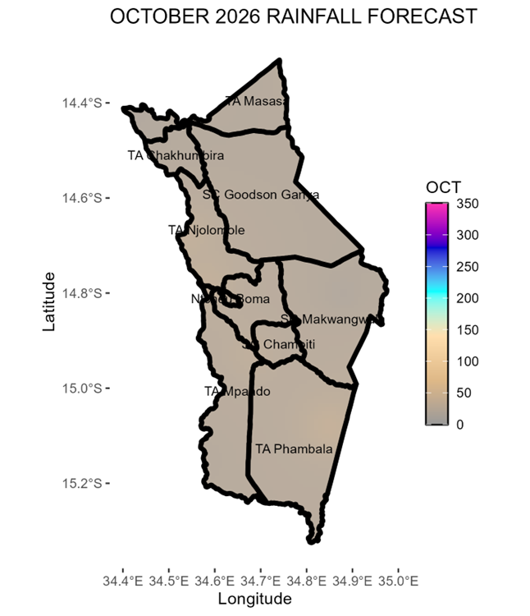
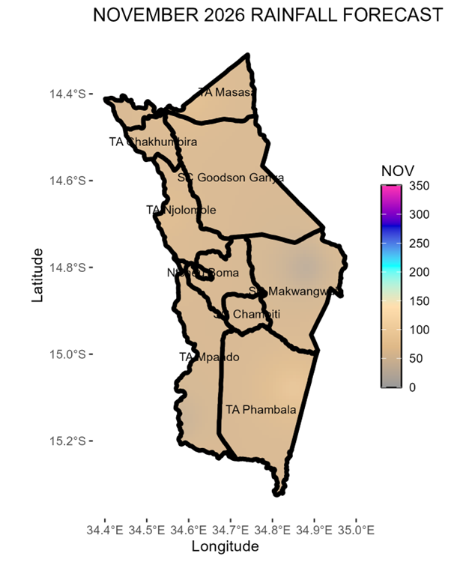
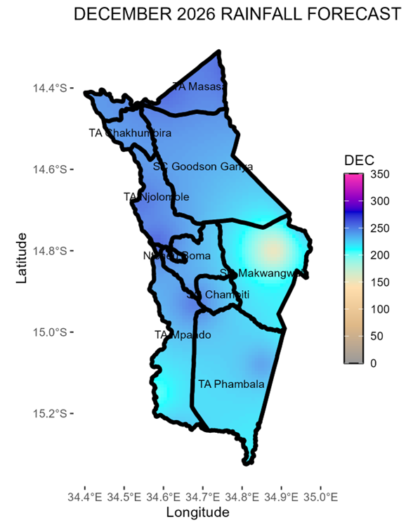
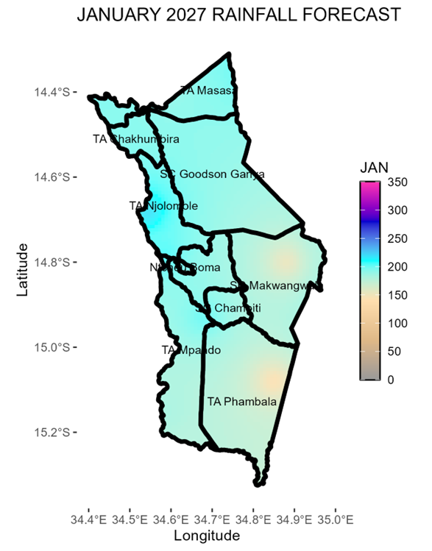
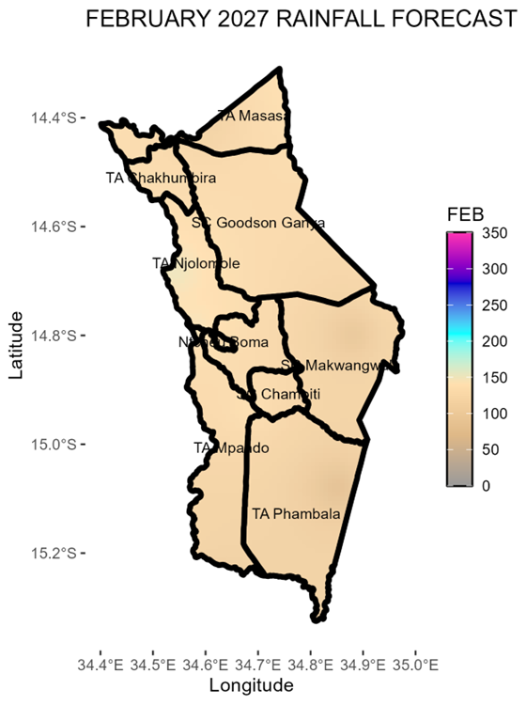
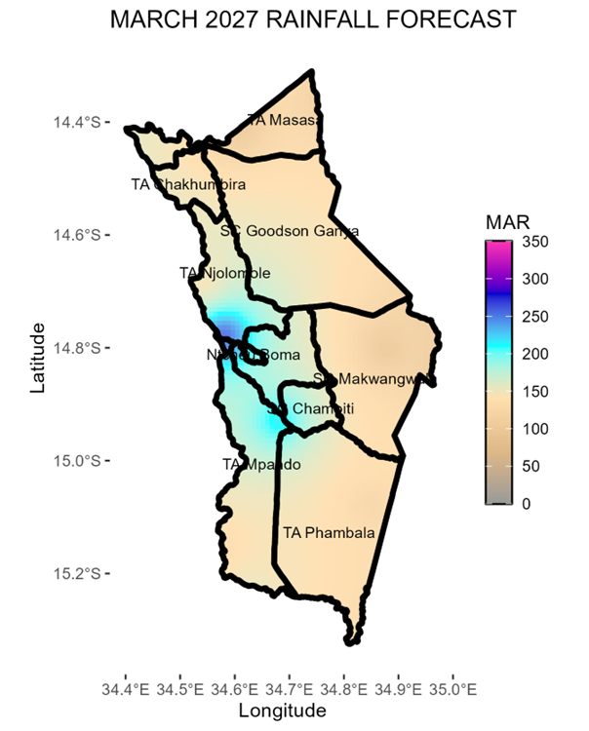
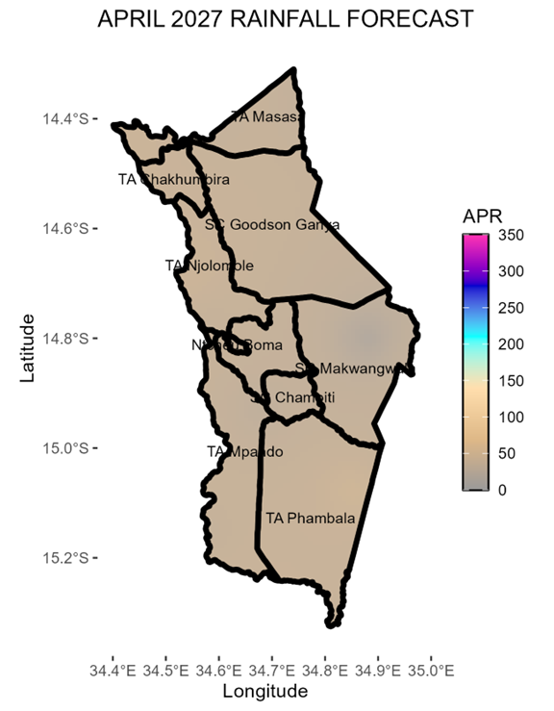
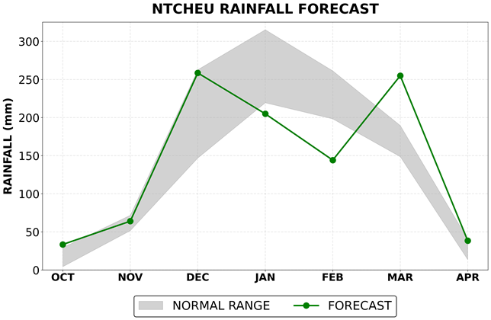

NTCHEU
The 2026-2027 rainfall season is expected to be influenced by a strong El Niño. El Niño is the unusual warming of waters over the central-eastern equatorial Pacific Ocean which affects global rainfall patterns.
Overview
Ntcheu district is expected to receive normal to below normal rainfall amounts during the 2026-2027 rainfall season.
October 2026
November 2026
During the month of October, most areas in Ntcheu are expected to be dry with few areas receiving chizimalupsya rains of less than 30 mm.
These rains will be accompanied by strong winds and lightning.
In November, most areas of the district will receive rainfall amounts in the range of 20 - 70mm.
Onset of the season is expected from the last week of November 2026 in some areas of the district.
December 2026
January 2027
  December is expected to be the wettest month of the season in the district. Rainfall amounts in the range of 170-250mm are expected over most areas.
  However, areas around SC Makwangwala will likely to receive rainfall amounts of about 140mm.
Most areas of the district are expected to receive rainfall amounts in the range of 140 - 240mm during the month of January.
There is likelihood of dry spells of a week during this month.
February 2027
March 2027
Most areas are expected to receive rainfall of about 150 mm in February. This signifies below normal rainfall amounts.
Threat of prolonged dry spells of about two weeks is likely during this month.
In March, most areas of the district are expected to receive rainfall ranging from 120 to 200 mm. However, areas around TA Mpando, SC Champiti, and Ntcheu Boma are expected to receive higher rainfall amounts of more than 220 mm.
April 2027
SEASON IN SUMMARY
Rainfall Onset Expected from the second week of December | Dry Spells Threat of prolonged dry spells of about one week in January and about two weeks in February. | Seasonal Length Expected to last 120 to 135 days | Cessation Expected during second to third week of April 2027
During the month of April, as the season will be coming to an end the rains expected will be less than 100mm.
Cessation is expected during the second and third week of April, 2027.
MONTH | NORMAL RANGE |  | FORECAST
OCT | 4.4 | 29.4 | 33.5
NOV | 51.7 | 71.8 | 64.0
DEC | 147.0 | 262.8 | 258.6
JAN | 219.4 | 315.3 | 205.0
FEB | 198.3 | 261.3 | 144.2
MAR | 148.7 | 189.6 | 254.9
APR | 13.6 | 40.4 | 38.4

